Slide 1

A PROJECT PRESENTATION ON
EASE MY BOOKING
Team Members:
Meghana Shenoy
Rakshitha Poojary

Slide 2



CONTENTS
1.Abstract .....1
2.Project overview .....2
3.Key Features .....3
4.API Gateway. .....6
5. ER Diagram. ....7
6.Tech Stack ...10

Slide 3
EaseMyBooking
In the modern age, the convenience of online solutions has extended to almost every aspect of daily life, yet many visitors still face the inconvenience of long queues when purchasing tickets for attractions such as zoos, museums, and other popular destinations. This project proposes an innovative online platform designed to alleviate this problem by allowing users to discover, book, and manage tickets for various attractions without the need to physically stand in line. The platform aims to provide a seamless experience for users while also offering owners a valuable tool for increasing visibility and maximizing profitability.
1

Slide 4


Project Overview
Objective:
To create a user-friendly online platform where visitors can explore all available attractions in a given location, view detailed information about each place, and purchase tickets directly through the website.
2

Slide 5

Key Features:
Online Booking System:
Simple and secure ticket purchasing process.
Options for different ticket types.
Instant online booking and e-tickets for easy entry.
Account Management:
Personal accounts for both customers and the owners of destinations to track their bookings, view purchase history.
3

Slide 6


BENEFITS
For Users:
Convenience: Users can browse and book tickets for attractions from home, bypassing long queues at ticket counters.
Comprehensive Information: Detailed attraction descriptions, images, and reviews help users make informed choices.
Offers: Offers by season allow customers to book destinations at reduced rates during off-peak times, making travel more affordable and accessible.
For Attraction Owners:
Increased Visibility: Listing on the platform exposes attractions to a larger audience, potentially boosting visitor numbers.
Efficient Management: An intuitive owner portal simplifies the management of listings, bookings, and pricing.
Revenue Growth: Dynamic pricing and promotional features enable owners to optimize ticket sales and enhance revenue
B A S I C
$490
4

Slide 7
SOLUTION
Value Proposition:
Enhanced Exposure: Demonstrate how listing on the platform can attract more visitors and increase ticket sales.
Easy Management: Showcase the simplicity of managing listings and tracking bookings through the owner portal.
Incentives:
Promotional Offers: Provide initial incentives such as reduced commission rates or free promotional features for early adopters.
Success Stories: Share case studies or testimonials from other attraction owners who have benefited from the platform.
Support and Training:
Onboarding Assistance: Offer support to help owners set up their listings and use the platform effectively.
Dedicated Support: Provide ongoing customer service to address any issues or questions.
P R E M I U M
$990
5

Slide 8
API Gateway
Api gateway
Localhost:8080
/locations
/{id}/destinations
/updateCustomer
/addBooking
/location/add
/destination/{did}
/updateOwner
/booking/{id}/createcancellation
/addbooking
/findAllCustomers
/booking/{id}
/location/delete/{id}
/addDestination
/booking/{id}/cancellation
/findAllOwners
/customer/{id}/bookings
/booking/payment/{id}
/destination/delete/{id}
/location/{id}
/findCustomerById/{id}
/destination/{id}/bookings
/destination/update
/findOwnerByID/{id}
LOCATION SERVICE
DESTINATION SERVICE
USER SERVICE
BOOKING SERVICE
CANCELLATION SERVICE
PAYMENT SERVICE
6

Slide 9
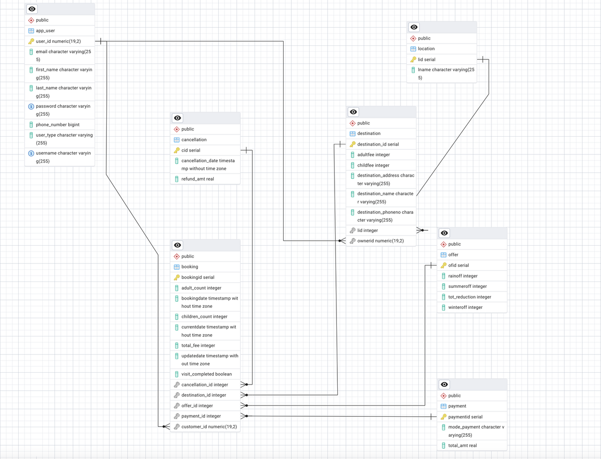
ER Diagram:
B A S I C
$490
7

Slide 10
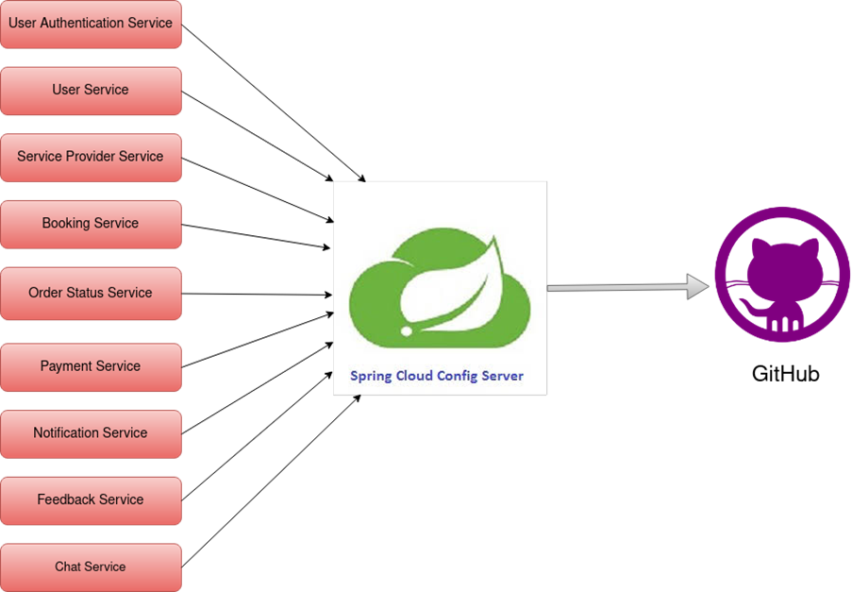
Future Scope
8

Slide 11
Conclusion
Our online ticket booking platform revolutionizes attraction access by eliminating long queues with a seamless digital solution. Users benefit from a centralized hub to easily discover and book tickets for various attractions from home. Attraction owners gain enhanced visibility and streamlined management tools, which can increase their revenue potential. The platform supports secure payments and offers dynamic pricing options to optimize income. By combining convenience for users with efficient operations for owners, we address key industry challenges. The development and launch of this platform will set the foundation for widespread adoption. Continuous feedback will drive improvements, ensuring the platform remains effective and user-friendly. This initiative promises to significantly enhance the visitor experience and operational efficiency
9

Slide 12






Tech Stack
Development
Database
Platform
10

Slide 13


